Slide 1

UNIVERSITI TEKNOLOGI MARA
MEM261 :
WORKSHOP PRACTICE II
CHAPTER 1
Workshop Safety Regulations
An introduction to safe practice, hazard control and emergency procedure in the mechanical engineering workshop.
MEM261 · Chapter 1 · Workshop Safety Regulations
1

Slide 2
Chapter Outline
1
1.1 Introduction — the purpose and goals of workshop safety
2
1.2 General Workshop Safety Rules, incl.
1.2.1 rules for machines
3
1.3 Industrial Safety — key definitions and concepts
4
1.4 Occupational Hazard and Control, incl.
1.4.1 PPE
5
1.5 Fire Safety — extinguisher classification
6
1.6 Important Workshop Signage, and chapter summary
MEM261 · Chapter 1 · Workshop Safety Regulations
2

Slide 3
OBJECTIVES & LEARNING OUTCOMES
By the end of this chapter, you will be able to:
01
02
03
Explain workshop safety
Use protective wear
Classify safety equipment
Acquire knowledge of the safety precautions required while working in the mechanical workshop.
Select and correctly use personal protective equipment appropriate to the task at hand.
Identify and understand workshop safety equipment, for example fire extinguishers.
MEM261 · Chapter 1 · Workshop Safety Regulations
3

Slide 4
1.1 INTRODUCTION
Why Workshop Safety Matters
The need for safety underpins the general goals of engineering practice. Every rule in this chapter serves one of the aims below.
1
Reduce accidents
Engineering safety goals exist to protect people first, and equipment, product and reputation second.
2
Control or eliminate hazards
3
Develop new methods and techniques to improve safety
4
Maximize returns on safety efforts
Guiding principle
5
Maximize public confidence with respect to product and service safety
MEM261 · Chapter 1 · Workshop Safety Regulations
4

Slide 5


1.2 GENERAL WORKSHOP SAFETY RULES
Basic Safety Rules
1.Before you can use equipment and machines, or attempt practical work in a workshop, you must understand these basic rules — they protect you and everyone around you.
1
Restricted access
2
Follow instructions
Free access to workshop areas is restricted to authorised personnel only.
Always listen carefully to the workshop supervisor (SIR/MADAM/DR) and follow their instructions.
MEM261 · Chapter 1 · Workshop Safety Regulations
5

Slide 6
1.2 GENERAL WORKSHOP SAFETY RULES
Basic Safety Rules
2. Safety in a machine shop divided into two:
1
Prevents worker injury
2
Prevents equipment damage
One category of machine-shop safety practice: those that prevent injury to workers.
The other category: those practices that prevent damage to machines and equipment.
MEM261 · Chapter 1 · Workshop Safety Regulations
5

Slide 7



1.2 GENERAL WORKSHOP SAFETY RULES
Before Entering the Workshop
Basic Safety Rules:
Wear the required PPE
1
2
Dress appropriately
Jewellery and loose clothing are prohibited. Long hair must be completely covered, and this applies especially to female students.
Students must arrive at each session on time, with proper dress code – Personal Protective Equipment :lab coat and shoes. Slippers are not allowed.
- it is your first line of defence.
6
MEM261 · Chapter 1 · Workshop Safety Regulations

Slide 8
1.2 GENERAL WORKSHOP SAFETY RULES
Before Entering the Workshop
Basic Safety Rules:
3
Enter the laboratory
4
Bags
Bags are not allowed in the laboratories.
Students are not allowed to enter the laboratory without permission from the lecturer, assistant lecturer, or assistant engineer, working alone or unsupervised in laboratories is forbidden.
.
6
MEM261 · Chapter 1 · Workshop Safety Regulations

Slide 9
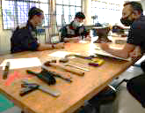
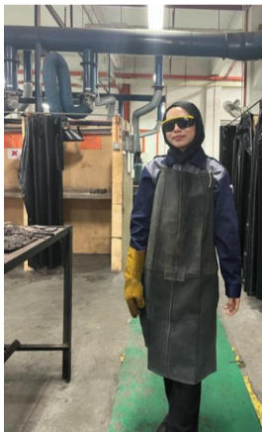
1.2 GENERAL WORKSHOP SAFETY RULES
Rules of Conduct in the Workshop
Read the instructions carefully and follow the laboratory procedures.
Do not touch anything that you are not completely familiar with.
1
2
Familiarise yourself with all equipment and tools used in the workshop
before you begin work.
3
Personal Protective Equipment (PPE) is provided and must be used wherever it is necessary.
Students are not allowed to run the machines when you are sleepy or under
medication.
4
Students are not allowed to eat, drink or smoke while working in the workshop
And are not allowed to run the machines with your hands wet.
5
MEM261 · Chapter 1 · Workshop Safety Regulations
7

Slide 10

1.2 GENERAL WORKSHOP SAFETY RULES
Rules of Conduct in the Workshop
Report any defective equipment to the workshop supervisor immediately.
6
Do not run in the workshop — you could collide with another student and cause an accident.
7
Always be patient. Never rush in the workshop.
8
MEM261 · Chapter 1 · Workshop Safety Regulations
7

Slide 11
1.2 GENERAL WORKSHOP SAFETY RULES · CONTINUED
Housekeeping and Tool Care
1
Keep gangways clear, clean and neat before and after the workshop activities. Any oil spillage, grease, etc. must be cleaned up immediately.
2
Clean as you go. Tools and equipment must be cleaned.
Keep the work area clean of all materials except those needed for your work.
3
Return equipment. Precision measuring equipment, drills, etc. must be replaced in their cabinets after each working day.
4
Carry tools safely. When carrying tools, sharp edges should be pointed downwards.
MEM261 · Chapter 1 · Workshop Safety Regulations
8

Slide 12
1.2 GENERAL WORKSHOP SAFETY RULES · CONTINUED
1
2
3
Tools and equipment
Evacuate for fire
Report everything
Tools and equipment must not be removed from the workshop without permission from the workshop supervisor.
In the event of a fire, leave the building immediately and proceed to the assembly point.
All unusual incidents — cuts, burns, direct chemical exposure — and emergencies must be reported to the supervisor, whether or not injury resulted.
MEM261 · Chapter 1 · Workshop Safety Regulations
9

Slide 13
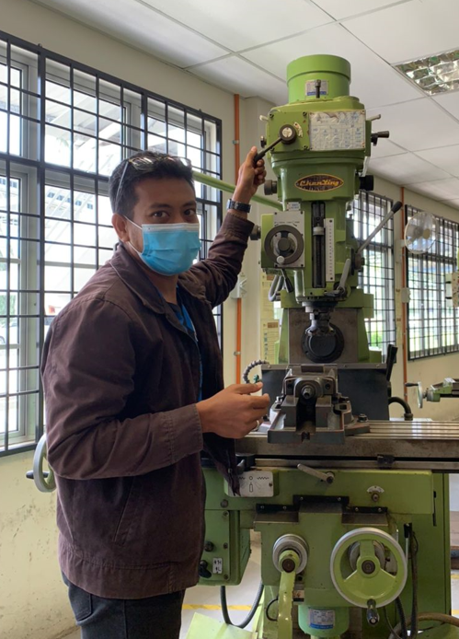
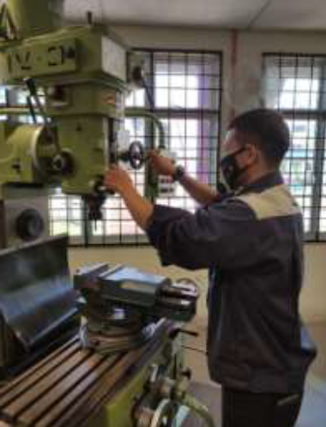
1.2.1 SAFETY RULES FOR MACHINES USED IN THE WORKSHOP
Operating Machines Safely
Read the Lab sheet procedure carefully and follow the safety and machining
procedures.
1
2
When working with rotating spindles, jewellery and loose clothing are
prohibited, and long hair must be completely covered.
3
When learning how to use a machine, listen very carefully to all instructions
given by the workshop supervisor — ask questions if you do not fully
understand.
4
Ensure that you are circuit and equipment connections are correct before
turning “ON” the power supply.
Use the appropriate machine for the work to be done.
5
MEM261 · Chapter 1 · Workshop Safety Regulations
10

Slide 14
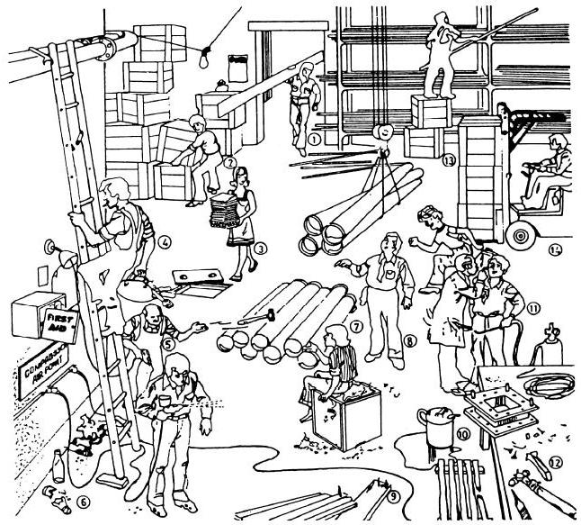
1.2.1 SAFETY RULES FOR MACHINES USED IN THE WORKSHOP
Operating Machines Safely
6
No machine may be used, and no work undertaken,
unless the supervisor is satisfied that you are
capable of doing so safely.
7
If a machine is fitted with guards, they must be used.
Equipment should never be used if the safety guards
have been removed.
8
Ensure that switches are “OFF”, the plugs are
unplugged, and the working area is cleaned before
you leave the workshop.
MEM261 · Chapter 1 · Workshop Safety Regulations

Slide 15
1.3 INDUSTRIAL SAFETY
Key Definitions — Events
Core concepts and definitions that frame every safety discussion in this course.
Accident
Incident
Ill Health
An undesired circumstance which gives rise to ill-health or injury, damage to property, plant, products or the environment, production losses, or increased liabilities.
Undesired circumstances and ‘near misses’ which could cause accidents.
Acute and chronic ill health caused by physical, chemical or biological agents, as well as adverse effects on mental health.
MEM261 · Chapter 1 · Workshop Safety Regulations
12

Slide 16
1.3 INDUSTRIAL SAFETY
Key Definitions — Hazard, Risk & Safety
Hazard
The potential to cause harm — including ill health and injury, damage to property, plant, products or the environment, production losses, or increased liabilities.
Risk
Safety
The likelihood that a specified undesired event will occur, due to the realisation of a hazard by, or during, work activities or by the products and services those activities create.
The ‘control of accidental loss.’
MEM261 · Chapter 1 · Workshop Safety Regulations
13

Slide 17
1.3 INDUSTRIAL SAFETY · OSH CONCEPT
From Hazard to Accident: The OSH Chain
Hazard / Danger
Risk
Harm
Accident
1
2
3
4
Damage to system elements, whether long- or short-term.
Observable, or predicted from knowledge.
Injuries, ill health, and damage.
→
Not directly observable — the probability of harm to system elements being realised from exposure to hazard and danger.
→
→
MEM261 · Chapter 1 · Workshop Safety Regulations
14

Slide 18
1.3 INDUSTRIAL SAFETY
Why Accidents Must Be Prevented
M
C
L
Moral / Humane
Cost
Legislation
No one comes to work to be injured or killed.
Accidents cost organisations money — in downtime, retraining and replacement.
Organisations carry a legal obligation to prevent workplace accidents.
Even a “near miss” hurts productivity
It costs time and money to retrain a new worker • new workers are initially less productive than experienced ones • goods or equipment lost must be replaced • other workers feel afraid or unhappy working somewhere that could injure or kill them — and this harms productivity.
MEM161 · Chapter 1 · Workshop Safety Regulations
15

Slide 19
1.3 INDUSTRIAL SAFETY
Occupational Safety & Health Governance in Malaysia
Government of Malaysia
↓
Ministry of Human Resources
↓
Department of Occupational Safety and Health (DOSH)
NIOSH
OSHA
National Institute of Occupational Safety and Health
Occupational Safety and Health Act functions
MEM261 · Chapter 1 · Workshop Safety Regulations
16

Slide 20
1.3 INDUSTRIAL SAFETY
The Role of DOSH
1
Standard setting
2
Policy study
Enforced under
• Occupational Safety and Health Act 1994 (Act 514)
• Factories and Machinery Act 1967 (Act 139)
• Petroleum (Safety Measures) Act 1984 (Act 302)
Standards on safety, health and welfare are reviewed, drafted and finalised from time to time, so they stay relevant to workplace conditions.
Existing OSH policies are studied periodically to assess how well they meet their objectives, and revised where needed.
Enforcement activities by DOSH include:
3
Drafting regulations
4
Enforcement
New regulations, codes of practice and guidelines are drafted and amended to help industry meet its obligations under the Act.
Enforcement activities protect the safety, health and welfare of workers under the Acts listed opposite.
Approval & authorization
Registration
iii. Certification
v. Inspection
Investigation
iv. Litigation
17
MEM261 · Chapter 1 · Workshop Safety Regulations

Slide 21
1.3 INDUSTRIAL SAFETY
NIOSH — National Institute of Occupational Safety and Health
NIOSH supports Malaysia's OSH system through five core responsibilities:
1
2
3
4
5
Training
Examination
Information services
Research & development
C1onsultation
Delivering OSH training programmes across industry.
Administering competency and certification examinations.
Publishing and disseminating OSH information.
Advancing OSH knowledge and practice.
Advising organisations on OSH matters.
MEM261 · Chapter 1 · Workshop Safety Regulations
18

Slide 22
1.3 INDUSTRIAL SAFETY
OSHA — Objectives, Scope & Application
Applies across industries including:
Objectives
• Secure the safety, health and welfare of persons at work against risks arising from work activities.
• Protect persons at a place of work, other than those at work, against similar risks.
Manufacturing
Mining & Quarrying
Construction
Agriculture, Forestry & Fishing
Utilities
Wholesale & Retail Trade
Scope
Finance & Insurance
Transport, Storage & Communication
Covers all working personnel, except:
• Armed Forces
• Crew of merchant ships
Hotels & Restaurants
Real Estate & Business Services
Public Service & Statutory Authorities
MEM261 · Chapter 1 · Workshop Safety Regulations
19

Slide 23
1.4 OCCUPATIONAL HAZARD AND CONTROL
What Is a Hazard?
Hazard: a substance or condition with the potential to cause injury in a given environment or situation.
• Industrial hazards may be defined as any condition/ substance produced by industries that may cause injury or death to personnel or loss of product or property.
•Safety in simple terms means freedom from the occurrence of risk or injury or loss. Industrial safety refers to the protection of workers from the danger of industrial accidents.
•Hazard is a potential of substance to cause damage
Risk: the probability that harm will occur under defined conditions of exposure to a hazard.
•In some industrial plants, by the nature of their activities and the substances they use, constitute hazards which are all the greater when they are located close to residential areas and their residents are particularly exposed in the events for accidents.
MEM261 · Chapter 1 · Workshop Safety Regulations
22

Slide 24
1.4 OCCUPATIONAL HAZARD AND CONTROL
Types of Industrial Hazards
Identifying industrial hazards, and the hierarchy of controls used to manage them.
1
Mechanical hazards (press machines and other machinery)
2
Electrical hazards
3
Safe use of lifts and escalators
4
Noise and vibration hazards
5
Radiation, pressurized environments and thermal stress
6
Transport activities and gas cylinder safety
7
Fire safety in buildings (Fire Services Act, Building Law)
8
Safety at construction sites
9
Chemical hazards and chemical safety management
MEM261 · Chapter 1 · Workshop Safety Regulations
21

Slide 25
1.4 OCCUPATIONAL HAZARD AND CONTROL
What Is a Hazard?
Workplace hazards can come from a wide range of sources. General examples include any substance, material, process, practice, etc. that has the ability to cause harm or adverse health effect to a person under certain conditions. See Table 1
Workplace Hazard | Example of Hazard | Example of Harm Caused
Thing | Knife | Cut
Substance | Benzene | Leukemia
Material | Asbestos | Mesothelioma
Source of energy | Electricity | Shock, electrocution
Condition | Wet floor | Slips, falls
Process | Welding | Metal fume fever
Practice | Hard rock mining | Silicosis
MEM261 · Chapter 1 · Workshop Safety Regulations
22

Slide 26
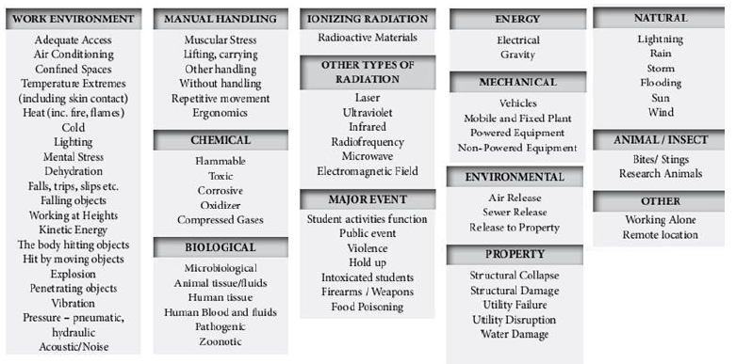
1.4 OCCUPATIONAL HAZARD AND CONTROL
Categories of Workplace Hazards
1
2
3
4
Physical
Chemical
Biological
Ergonomic
Noise, vibration, temperature, lighting
Fumes, dust, corrosives, solvents
Bacteria, viruses, moulds
Poor posture, repetitive strain, manual handling
5
6
7
8
Psychosocial
Energy sources
Natural
Property & security
Stress, workload, bullying, long hours
Electricity, pressurised systems, radiation
Heat, flooding, extreme weather
Theft, fire, unsafe premises
MEM261 · Chapter 1 · Workshop Safety Regulations
23

Slide 27
1.4 OCCUPATIONAL HAZARD AND CONTROL
Identifying Hazards at the Workplace
Observe your workplace
Investigate complaints from workers
1
2
Examine accident and near-miss records
Examine sickness figures
3
4
Use simple surveys to ask co-workers about health and safety concerns
Use checklists to help inspect your workplace
5
6
Learn the results of inspections by the employer, the union, or anyone else
Read reports or other information about your workplace
7
8
MEM261 · Chapter 1 · Workshop Safety Regulations
24

Slide 28
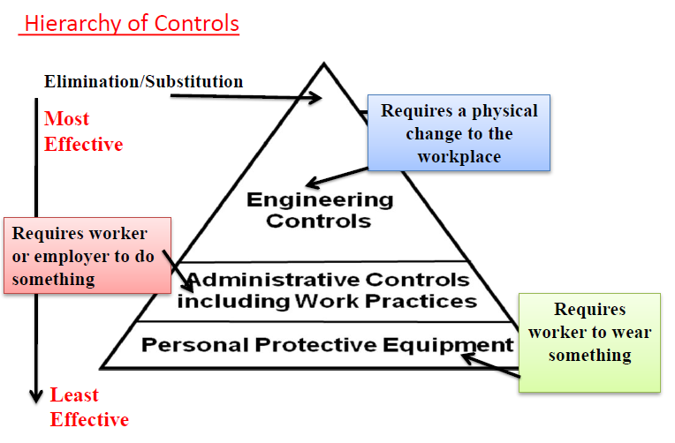
1.4 OCCUPATIONAL HAZARD AND CONTROL
Hierarchy of Controls
Most effective
Elimination & Substitution
Most effective — requires a physical change to the workplace
Engineering Controls
Requires a physical change to the workplace
Administrative Controls
Requires the worker or employer to do something
Personal Protective Equipment
Least effective — requires the worker to wear something
Least effective
MEM261 · Chapter 1 · Workshop Safety Regulations
25

Slide 29
1.4 OCCUPATIONAL HAZARD AND CONTROL
Eliminate/Substitution & Engineering Controls
Elimination & Substitution
Engineering Controls
At the source of the hazard:
Redesign
Isolation
Elimination — Getting rid of a hazardous job, tool, process, machine or substance entirely — e.g., a business decides to stop buying and cutting up scrapped bulk fuel tanks.
Rework jobs or processes to be made safer, e.g. easier to hold or lift.
If a hazard cannot be eliminated, isolate it — e.g. store flammables away from work areas.
Automation
Substitution — Sometimes doing the same work in a less hazardous way is possible — e.g., replacing a hazardous chemical with a less hazardous one.
Use dangerous processes robotically, protecting workers from direct exposure.
Barriers
Guarding that prevents contact with moving parts or hazardous zones.
Absorption & dilution
Absorb energy released, or dilute a hazard, e.g. ventilation systems dilute toxic gases.
MEM261 · Chapter 1 · Workshop Safety Regulations
26

Slide 30
1.4 OCCUPATIONAL HAZARD AND CONTROL
Administrative Controls
Administrative Controls
1
Safe work procedures expected practices, periodically reviewed and refreshed.
2
Training & supervision appropriate supervision helps identify hazards and evaluate work practices.
3
Job rotation reduces the time each worker is exposed to a hazard.
4
Housekeeping cleaning, waste disposal and spill cleanup keep hazards contained.
5
Hygiene practices shower and change clothing where applicable, to avoid taking toxic hazards home.
MEM261 · Chapter 1 · Workshop Safety Regulations
27

Slide 31
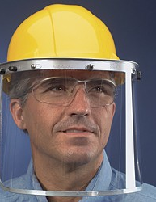
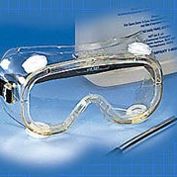

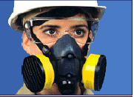
1.4.1 PERSONAL PROTECTIVE EQUIPMENT (PPE)
PERSONAL PROTECTIVE EQUIPMENT (PPE)
PPE — the control of LAST RESORT
Purpose: to increase individual safety while performing a potentially hazardous task.
1
Eye protection
2
Hearing protection (mandatory above 85 dB for more than 8 hours)
3
Dust masks
4
Foot wear
5
Gloves
6
Laboratory coats
7
Body protection
MEM261 · Chapter 1 · Workshop Safety Regulations
27

Slide 32
1.5 FIRE SAFETY
Fire Extinguisher Classification
Every workshop must be equipped with a fire extinguisher. When selecting the appropriate type, the class of combustible material present must be considered.
CLASS A
CLASS B
CLASS C
CLASS D
RED
LIGHT YELLOW
BLACK / GREEN
LIGHT BLUE
Combustible materials such as wood, cloth, paper, rubber and many plastics.
Flammable liquids and gases, oils, greases, tars, oil-based paints, lacquers, some plastics.
Class A and/or B materials in the presence of live electrical equipment, motors, switches and wires.
Combustible metals such as magnesium, titanium, sodium, potassium, zirconium and lithium.
MEM261 · Chapter 1 · Workshop Safety Regulations
28

Slide 33
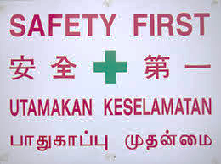
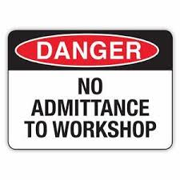

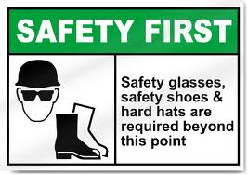


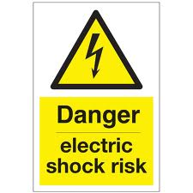
1.6 IMPORTANT WORKSHOP SIGNAGE
Reading Workshop Safety Signs
SAFETY FIRST · UTAMAKAN KESELAMATAN
⊘
●
▲
■
Prohibition
Mandatory
Warning
Safe Condition
Red circle with diagonal bar — e.g. No Admittance, No Naked Flame.
Blue circle — e.g. Wear Safety Glasses, Wear Safety Boots.
Yellow triangle — e.g. Danger, Keep Hands Clear of Moving Machinery.
Green square — e.g. Fire Exit, First Aid Point, Assembly Point.
MEM261 · Chapter 1 · Workshop Safety Regulations
29

Slide 34
CHAPTER SUMMARY
What You Should Take Away
1
1.1 Workshop safety serves engineering's broader goals: fewer accidents, controlled hazards, and public confidence.
2
1.2 General and machine-specific rules protect workers and equipment — from PPE and dress code, to guards and permissions.
3
1.3 Accidents follow a chain: hazard → risk → harm → accident. Malaysia's OSH system (DOSH, NIOSH, OSHA) governs this.
4
1.4 Hazards are identified and managed through the hierarchy of controls — elimination first, PPE last.
5
1.5 & 1.6 Fire extinguishers are matched to material class; signage communicates hazard and instruction at a glance.
MEM261 · Chapter 1 · Workshop Safety Regulations
30

Slide 35
REFERENCES
Sources Cited in This Chapter
1
Bawa, H. S. (1995). Workshop Technology. New Delhi: Tata McGraw-Hill.
2
Kalpakjian, S., & Schmid, S. R. (2010). Manufacturing Processes for Engineering Materials (6th ed.). Prentice Hall.
3
Farrah, N. (2013). Introduction to Bench Fitting [PDF document]. Retrieved from http://i-learn.uitm.edu.my/v2/
4
Rao, P. N. (2001). Manufacturing Technology: Foundry, Forming and Welding. New Delhi: Tata McGraw-Hill.
MEM261 · Chapter 1 · Workshop Safety Regulations
31

